Slide 1


Energy Hog
vs.
Hog Busters
Notes:
Teacher instructions are on last slide.

Slide 2
1. Saving Energy
2. Energy Sources
3. Energy Choices
4. Taking Action
5. Efficiency Tricks
10
10
10
10
10
20
20
20
20
20
30
30
30
30
30
40
40
40
40
40
50
50
50
50
50
Notes:
This is the button page

Slide 3
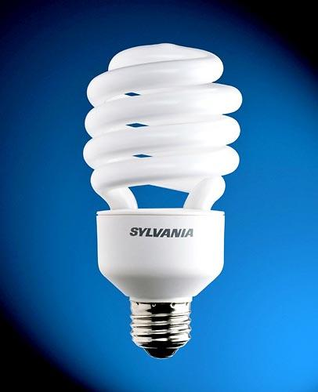

110. Which is more energy efficient: a CFL or incandescent light bulb?
    Answer: CFL
Notes:
Photos taken from:
https://lorrainecyr.wordpress.com/2010/02/01/energy-saving-light-bulbs/
http://www.flickr.com/photos/caveman_92223/3346906435/

Slide 4

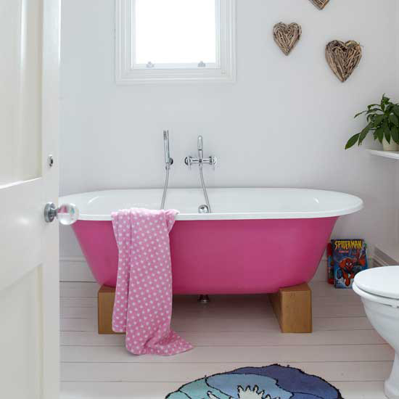
120. Which saves more energy: taking a bath or a shower?
Answer: Shower —
it uses less hot water
Notes:
Photos taken from:
http://www.sodahead.com/living/do-you-say-take-or-get-a-shower/question-1525277/?link=ibaf&q=shower&imgurl=http://4.bp.blogspot.com/_cbe3m3jV_iQ/TIg53dkkeiI/AAAAAAAAAxE/YPu3PLR7v8s/s1600/0511-0901-0516-4420_Man_Singing_in_the_Shower_clipart_image.jpg.png

Slide 5
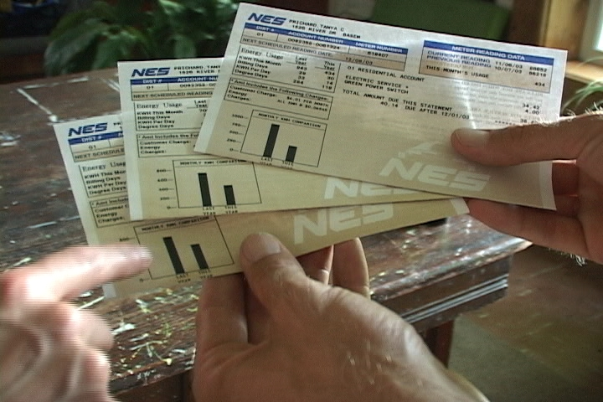
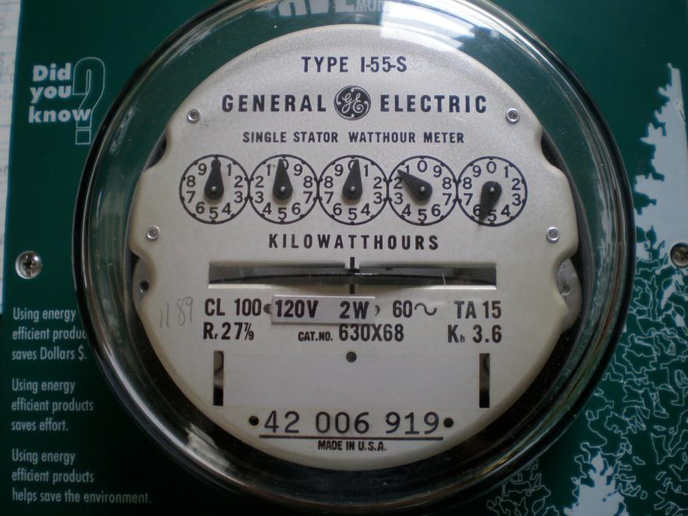
130. True or false: saving energy equals saving money
Answer: True
Notes:
Photo from: Kilowatt Ours

Slide 6

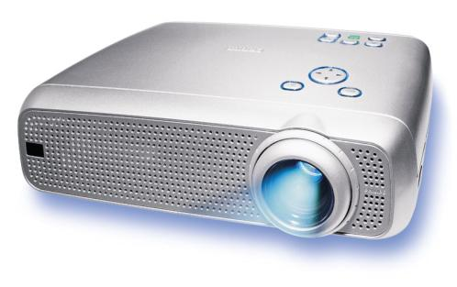
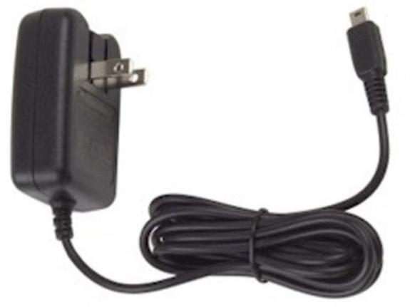

140. When something is losing energy does it feel warm or cold?
Answer: warm
Notes:
Photo taken from Alliance to Save Energy

Slide 7
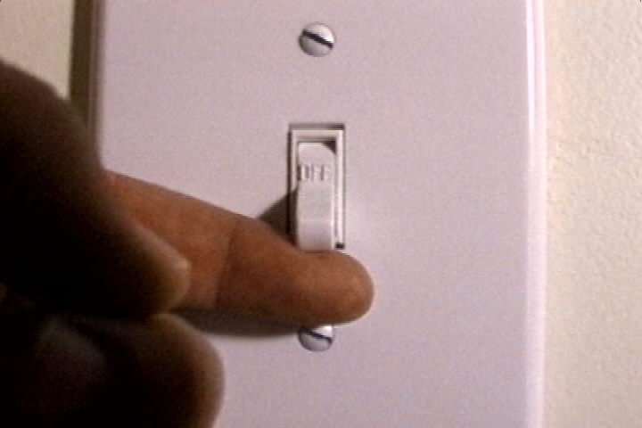
150. What should you do when you leave a room?
Answer: Turn off (or unplug)
Notes:
Photo from: Kilowatt Ours

Slide 8
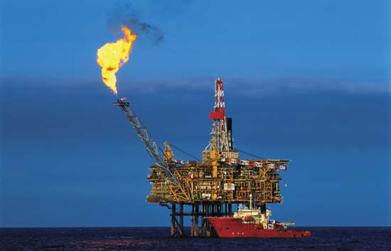
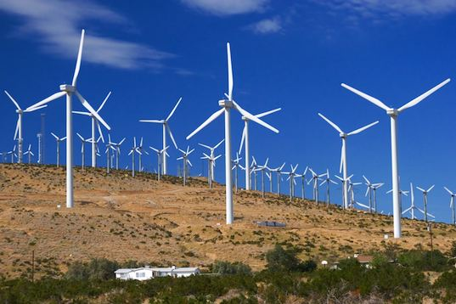
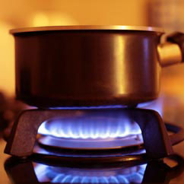
210. Which is a renewable energy source: wind power or natural gas?
    Answer:
    wind power
Notes:
Photos taken from:
http://www.heatingoil.com/category/blog/natural-gas-blog/
http://inhabitat.com/texas-breaks-u-s-wind-power-generation-record/
http://www.oerb.com/Default.aspx?tabid=331&ArticleId=77

Slide 9
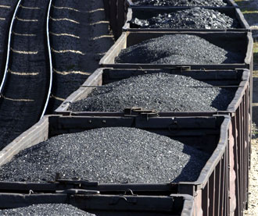
220. What type of fuel is coal?
Answer: non-renewable (or fossil)
Notes:
Photo from: Kilowatt Ours

Slide 10

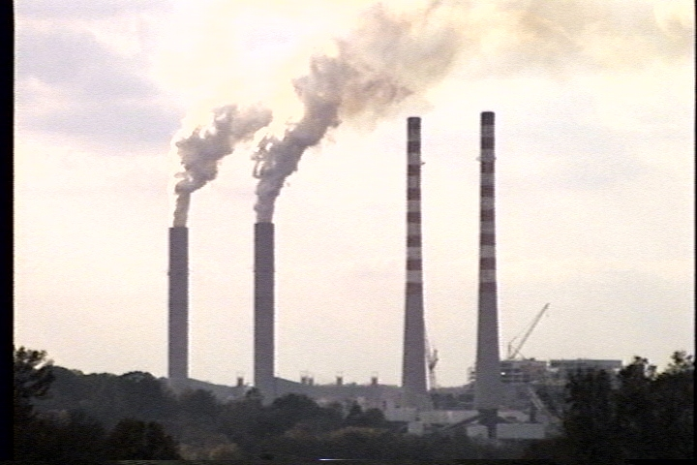
230. What are two non-renewable energy sources?
    Answers: oil, coal, natural gas, uranium
Notes:
Photos taken from :
http://www.planethopia.info/global-warming/how-fossil-fuels-are-affecting-global-warming/
http://www.catastrophemonitor.com/2011/05/how-nuclear-power-works/

Slide 11
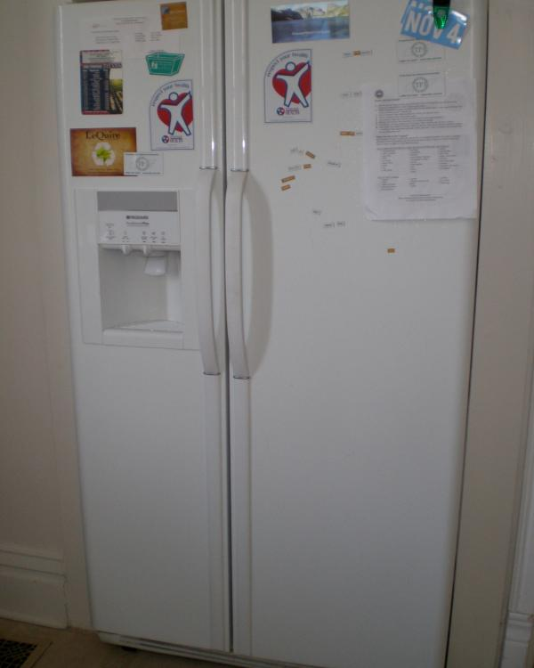
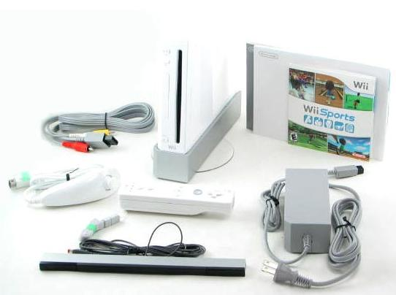
240. Which uses more energy, a Wii or a refrigerator?
Answer: Wii
Notes:
Photos taken from:
Jennifer Barrie
http://www.infobarrel.com/Cheap_Refurbished_WII_Consoles_Saving_in_Gaming

Slide 12
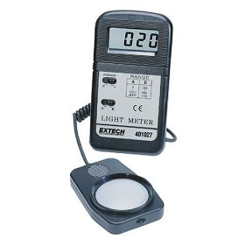
250. What does a footcandle meter measure?
Answer: amount of light or light level in a space
Notes:
Photo taken from Alliance to Save Energy

Slide 13
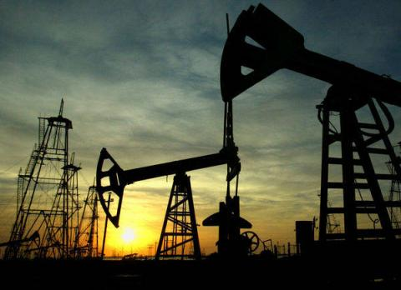
310. Oil is also known as a _____ fuel (think dinosaurs).
Answer: Fossil (or non-renewable)
Notes:
Photo taken from :
http://thomko.squarespace.com/types-of-oil/

Slide 14
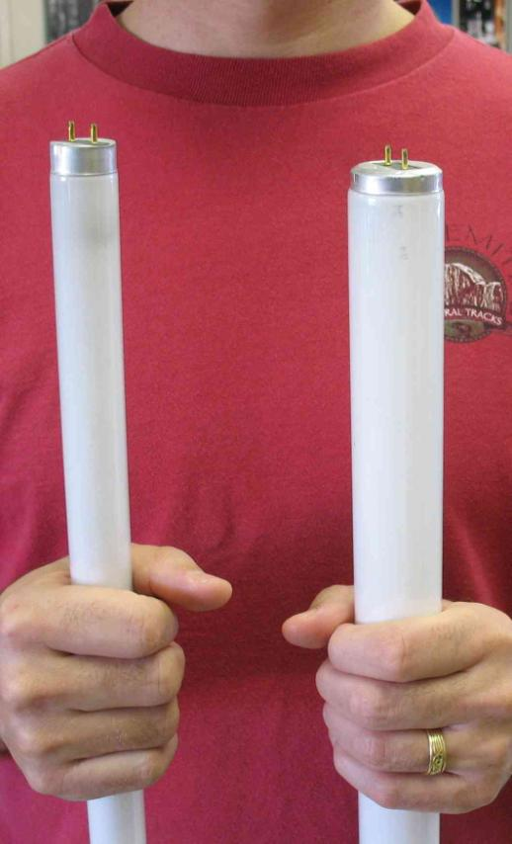
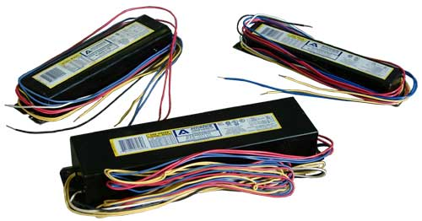
320. Which is more efficient: a T-8 or T-12 bulb?
Answer: T8 (or electronic ballasts)
← T8
T12 →
Notes:
Photos taken from :
http://www.phonemag.com/major-phone-manufactures-introduce-new-energy-rating-system-in-an-effort-to-save-energy-115665.php
http://www.whitegadget.com/new-laptop-releases/22210-pictures-latest-brand-sony-laptop.html
http://www.plasma.com/philipsprojectors/lc4431.htm

Slide 15
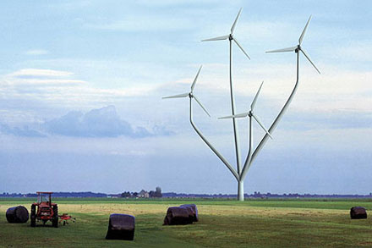
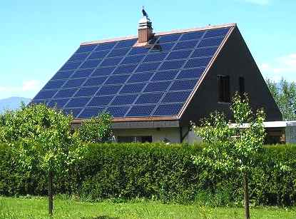
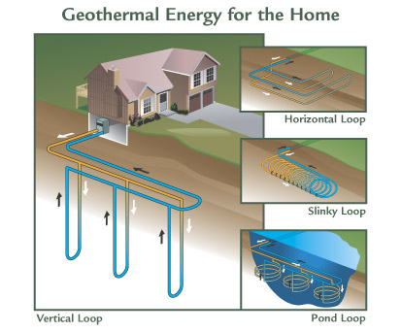
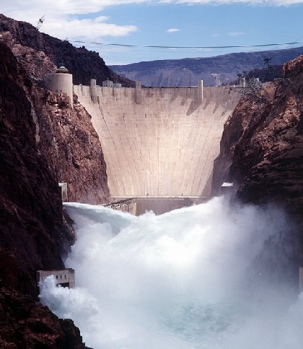
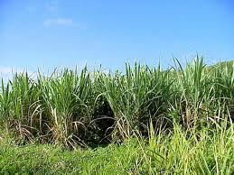
330. What are two renewable energy sources?
Answers: wind, solar, geo-thermal, gravitational (or hydro/water), ocean, biomass
Notes:
Photos taken from:
http://www.solarnavigator.net/solar_panels.htm
http://science.howstuffworks.com/environmental/energy/hydropower-plant.htm
http://renewables-energy.net/2011/08/05/uses-of-biomass-energy/

Slide 16
340. Looking at the picture below, which part of the house could lose energy?
Answer:
all parts indicated

Slide 17
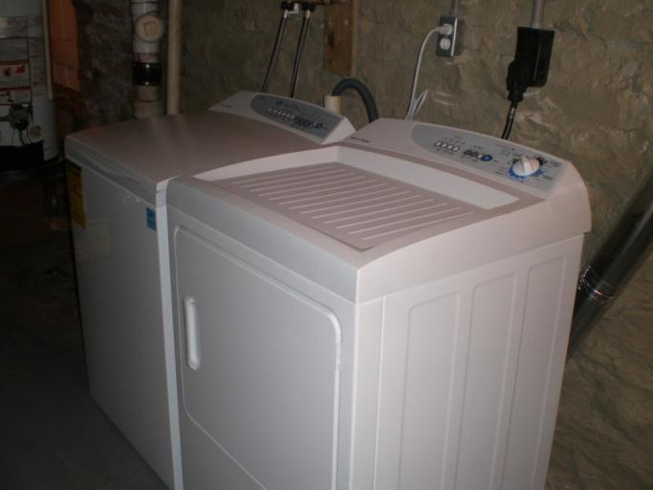
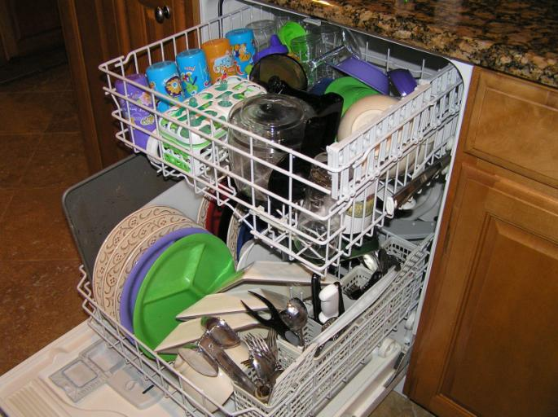
350. What is one appliance that should only be run when fully loaded?
Answer: dish washer or washing machine
Notes:
Photos from:
Jennifer Barrie
http://www.celsias.com/article/financial-crisis-households-more-energy-conscious/

Slide 18
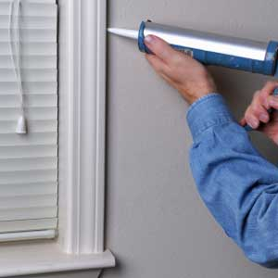
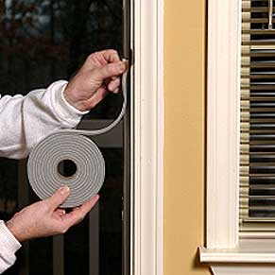
410. What can you use to seal cracks around windows and doors?
Answer: caulk (also weather stripping or insulation)
Notes:
Photos from :
http://www.appomattoxnews.com/2009/do-you-have-pcbs-in-your-building-caulk.html
http://stopbuggn.com/news/weather-strippingthe-best-barrier-to-stop-buggn

Slide 19
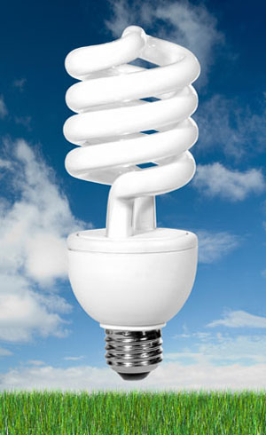
420. What does CFL stand for?
Answer:
Compact
Florescent
Lamp
(or light bulb)
Notes:
Photo from:
http://www.guavabee.com/2010/10/free-cfl-bulbs.html

Slide 20
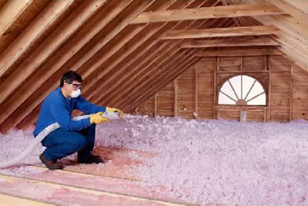
430. What keeps heat from escaping through the roof of your home?
    Answer: Insulation (and sealing cracks)
Notes:
Photo from :
http://www.baerheatandair.com/pinkisgreen.html

Slide 21

440. What is the unit used to measure electricity?
Answer: Watt (or kilowatt)
Notes:
Photo from:
http://www.yurto.com/get-rewards-with-your-monthly-electricity/

Slide 22

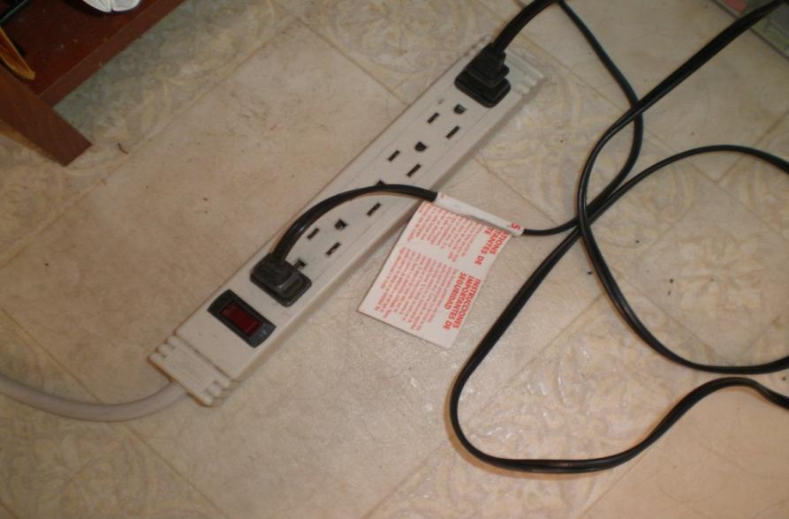
450. When an appliance is using energy even when it's turned off, what is that called?
    Answer: phantom load or vampire load
Notes:
Photo taken by Jennifer Barrie

Slide 23

510. Looking at the picture below, what does this symbol mean?
Answer: Products with the Energy Star symbol are rated as energy efficient.
Notes:
Photo from www.energystar.org

Slide 24
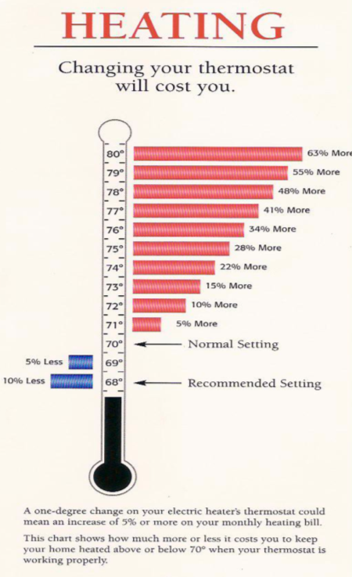
520. True or false: Every degree you adjust your thermostat makes a difference to your heating and cooling cost.
Answer: True
Notes:
Photo taken by Jennifer Barrie

Slide 25

530. Name some actions that can be taken at school to save energy & money.
    Answer:
    We can turn off the lights and computers when they are not in use.
    We can adjust the temperature of the room
    We can use daylighting
    We can conduct a school energy audit and present recommendations for change to the administration and school board.
    We can start an energy efficiency campaign on campus. Are there other ideas?
Notes:
Photo from Alliance to Save Energy

Slide 26
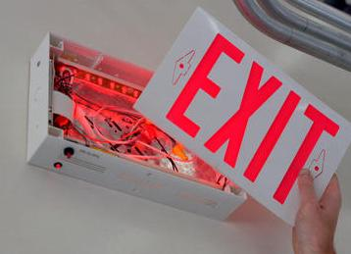
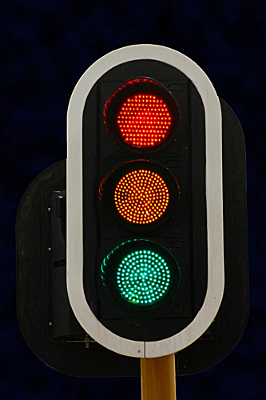
540. What can be done to traffic signals and exit signs to save energy and money?
    Answer: Traffic signals and exit signs can be upgraded to LED bulbs, which are very energy efficient. They use 90% less energy than incandescent bulbs.
Notes:
Photo from:
http://alt-e.blogspot.com/2005/04/energy-efficiency-led-lights-to.html

Slide 27


550. What is the best way to make sure that your computer is not an energy vampire?
Answer: Use the Power Save setting to conserve energy!
Notes:
Photo from www.greenpowerswitch.org

Slide 28


Thank you for playing!
Energy Hog
vs.
Hog Busters
Notes:
This PowerPoint presentation can be used with Activity 9 in the Kilowatt Ours Companion Curriculum: “Kilowatt Ours Quiz Show”.

Slide 29





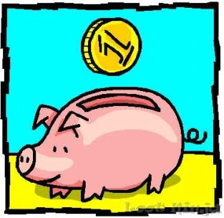
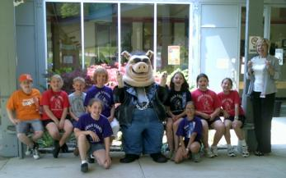
Final Round
List as many reasons as you can why it is important to get rid of Energy Hogs?
Reduce CO₂
Reduce Air Pollution and Asthma
Save Money
Can you think of more?

Slide 30
Teacher Instructions
    The game should be played like jeopardy, but students do not need to answer in question format.
    Click on the question slides, or use the forward arrow or space bar to make the answer appear.
    3. The back arrows on the bottom right corner of each slide will take you back to the button page, where students can pick the level of question they would like to answer.
    4. Some of the questions are basic for anyone to answer, some are more specific for students who have learned about energy.
    5. Most importantly, have fun!

Slide 31
Resources

