Slide 1


Accelerate Energy Productivity 2030
Dr. Gayle Schueller
Vice President, Global Sustainability, 3M
Thursday, July 16, 2015

Slide 2
3M facts
3M is one of 30 companies in the Dow Jones Industrial Average and is a component of the Standard & Poor’s 500 Index
Year-end 2014
Sales
Worldwide $31.821
International $20.107
63% of company’s total
Net income
Net income – reported $4.956 billion
Percent to sales 15.6%
Earnings per share – diluted – reported $7.49
Taxed
Income tax expense $2.028 billion
Dividends
Paid every quarter since 1916
Cash dividends paid per share $3.42
One original share, if held, is now 3,072 shares
R&D and related expenditures
For 2014 $1.770 billion
Total for last five years $8.123 billion
Capital spending
For 2014 $1.493 billion
Total for last five years $7.112 billion
Employees
Worldwide 89,800
United States 35,581
International 54,219
Patents awarded
In 2014 US 625; TOTAL 3,342
In company history 100,000+
Organization
27 business units, managed under these five business groups:
Consumer
Health Care
Safety & Graphics
Operations in about 30 US states and 70 countries around the world.
Laboratories in 36 countries.
Technology
46 technology platforms, including:
Abrasives
Adhesives
Electronics & Software
Light Management
8,500 researchers worldwide: 4,600 in the United States.
Sustainability results
Prevented the generation of nearly 4 billion pounds of pollutants since 1975 through completion of nearly 11,800 Pollution Prevention Pays (3P) projects.
Listed on Dow Jones Sustainability Index for 15 consecutive years.
Signatory member of UN Global Compact supporting 10 principles in the areas of human rights, labor, environment and anti-corruption.
Community citizenship/3Mgives
3M cash and product donations to education, community and environmental programs total $77 million in 2014; $1.4 billion since 1953.
3M employees and retirees volunteered more than 300,000 hours improving lives around the world.
Electronics & Energy
Industrial
Microreplication
Nanotechnology
Nonvoven Materials
Surface Modification

Slide 3
Who we are
1902
Improving lives since

Slide 4
Our Vision
3M Technology Advancing Every Company
3M Products Enhancing Every Home
3M Innovation Improving Every Life
Notes:
It is ambitious. Aspirational. Challenging. And attainable.
Not just because of what we do, but because of how we do it.
We are a company rooted in scientific exploration and discovery … and the belief that every problem has a solution.
And it sums up in our ambition to improve every life.

Slide 5
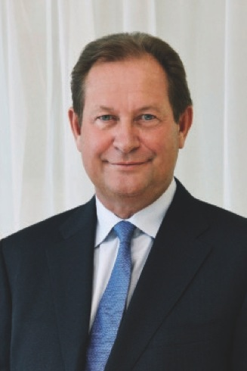
“Put simply, we are committed to improving our business, our planet, and every life.”
– Inge Thulin Chairman, President and CEO
Notes:
Our CEO is heavily committed to using science, technology and 3Mer passion and collaboration, to address some of the world greatest challenges. It’s in our Vision and part of how we operate every day.

Slide 6
46 core technology platforms
Ab
Abrasives
Ad
Adhesives
Fi
Films
Md
Medical Data Management
Am
Advanced Materials
Fl
Fluoro-materials
Ec
Energy
Components
Mf
Mechanical Fasteners
Ce
Ceramics
Nt
Nano-technology
Ac
Acoustic Control
Fe
Flexible Electronics
Mi
Microbial Detection and Control
Co
Advanced
Composites
Nw
Nonwoven Materials
Mo
Molding
Pe
Predictive Engineering & Modeling
Rp
Radiation Processing
An
Analytical
Fc
Flexible Converting & Packaging
Pr
Process Design & Control
Bi
Biotech
Fs
Filtration, Separation, Purification
Op
Opto-electronics
Do
Dental & Orthodontic Materials
Po
Porous Materials & Membranes
Mr
Micro-replication
Pm
Polymer Processing
Su
Surface Modification
As
Application Software
In
Inspection & Measurement
Se
Sensors
Dd
Drug Delivery
Im
Imaging
Tt
Track and Trace
Em
Electronic Materials
Sm
Specialty Materials
Pd
Particle & Dispersion Processing
Pp
Precision Processing
Vp
Vapor Processing
Es
Electronics & Software
Is
Integrated Systems & Design
We
Accelerated Weathering
Di
Display
Lm
Light Management
Wo
Wound Management
Materials
Processing
Capabilities
Applications
Notes:
Many other companies have adopted our 15 percent rule. Yet what remains unique to 3M is the breadth and diversity of our technology pool … which reflects our uncommon approach to R&D. At 3M, we do R&D a bit differently: we separate the R and the D.
Scientists in our central laboratory are free to focus on pure research … looking for unscripted, unexpected opportunities for breakthroughs.
3M development teams within each of our five business groups then draw upon those core technologies to develop products for targeted markets and geographies. These are our 46 core technology platforms … which range from adhesives and abrasives, to sensors and electronics materials.
Our team has the uncanny ability to combine and use the technologies in creative ways.
That’s how a mixing technology originally created for dental crowns made its way into automotive applications, too.
Another example is our all-weather paint used to mark pavement … part of 3M’s legacy of making roadways safer. Our scientists combined three technologies to make this highly reflective paint that’s visible even in rain … Abrasives, Adhesives and Nonwoven Materials.

Slide 7
3M technology platforms and market diversity
Adhesives
Automotive and aerospace
Abrasives
Consumer and office
Ceramics
Electro and communications
Electronic Packaging
Microreplication
Home and leisure
Integrated systems design
Manufacturing and industry
Light management
Healthcare
Specialty materials
Safety and security
Fibres
Polymeric smelting
Display and graphics
Notes:
We’ve become pretty adept at taking a technology that has been developed to provide solutions for one market and then applying it elsewhere, to create often quite different solutions in totally unrelated markets.
We call that ‘technology transfer’.

Slide 8

100,000
patents
Notes:
In May 2014, 3M achieved an innovation milestone: we received our 100,000th patent.
This is a testament to our scientific strength.
Yet the real power of 3M is our ability to apply science to life.

Slide 9

15 percent culture: creativity needs freedom.
Since 1948, 3Mers have been encouraged to use 3M resources, to build up a unique team and to follow their own insights in pursuit of problem-solving – and to spend 15 percent of their working time to do it.
Notes:
A core belief at 3M is that creativity needs freedom. That’s why, since about 1948, we’ve encouraged our employees to take our resources, to build up a unique team and to follow their own insights in pursuit of problem-solving — and to spend 15 percent of their working time to do it.
That initiative is alive and well today, and has led to some of our most ingenious inventions, including:
Automobile window treatment films … which enhance comfort, security and privacy in your vehicle.
Multi-layer optical film, which reflects 95 percent of all light. It’s likely in your laptop, smart phone and big-screen TV … making the screen brighter, while reducing energy use.

Slide 10

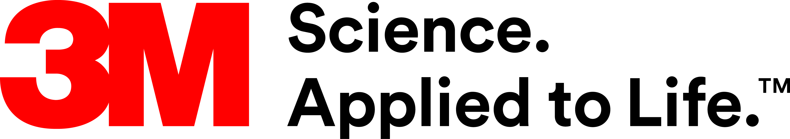
Our Every Life Ambition
At 3M, we are committed to improving our business, our planet, and every life.
Notes:
But an ambition that big won’t be easy. So we at 3M pledge the following:
To push ourselves to create the science and technology to achieve these goals.
To encourage individual passion and curiosity - within the company, with our partners, and within our communities.
To acknowledge that we cannot succeed alone and commit to stimulating and supporting collaborations to improve every life on earth.

Slide 11
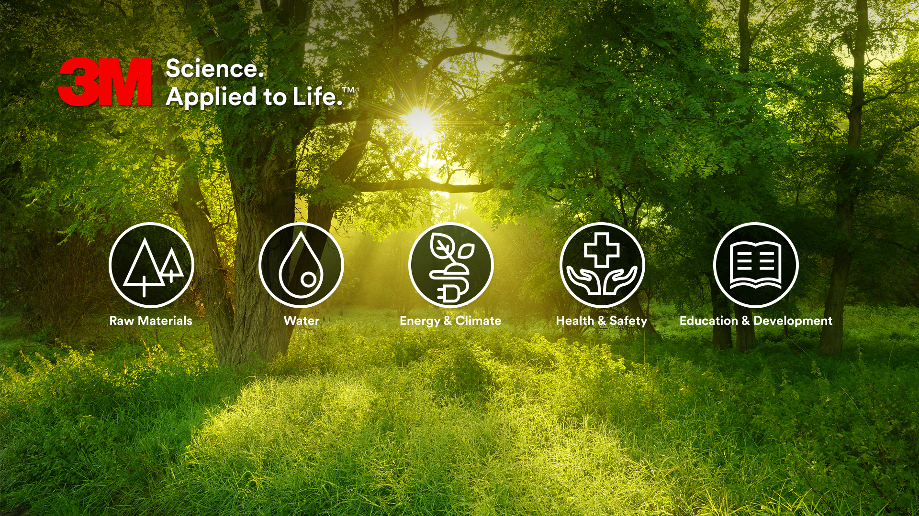
3M’s Technology & Innovation Can Help Solve these Challenges
Notes:
Toward that ambition, we have framed our goals and plans around those shared global challenges. Recognizing the interconnections and overlap of the commitments we’re making and their impact on multiple challenges, we have organized our efforts by the primary challenge each goal is working to overcome.

Slide 12
Our sustainability progress
Notes:
Sustainability is not a new concept at 3M. We’ve been improving lives since 1902 and are continuously improving our process, programs and goals, to address the challenges of today … and tomorrow.

Slide 13
Raw Materials
• Invest to develop more sustainable materials and products to help our customers reach their environmental goals
• Reduce manufacturing waste by an additional 10%, indexed to sales
• Achieve “zero landfill” status at more than 30% of manufacturing sites
• Drive supply chain Sustainability through targeted raw material traceability and supplier performance assurance.
Water
• Reduce global water use by an additional 10%, indexed to sales
• Engage 100% of water-stressed/scarce communities where 3M manufactures on community-wide approaches to water management
Our 2025 sustainability goals
Energy & Climate
• Improve energy efficiency indexed to net sales by 30%
• Increase renewable energy to 25% of total electricity use
• Ensure GHG emissions at least 50% below our 2002 baseline, while growing our business
• Help our customers reduce their GHGs by 250 million tons of CO₂ equivalent emissions through use of 3M products
Education & Development
• Invest cash and products for education, community and environmental programs
• 100% participation in employee development programs to advance individual and organizational capabilities
• Double the pipeline of diverse talent in management to build a diverse workforce
Health & Safety
• Provide training to 5 million people globally on worker and patient safety.

Slide 14
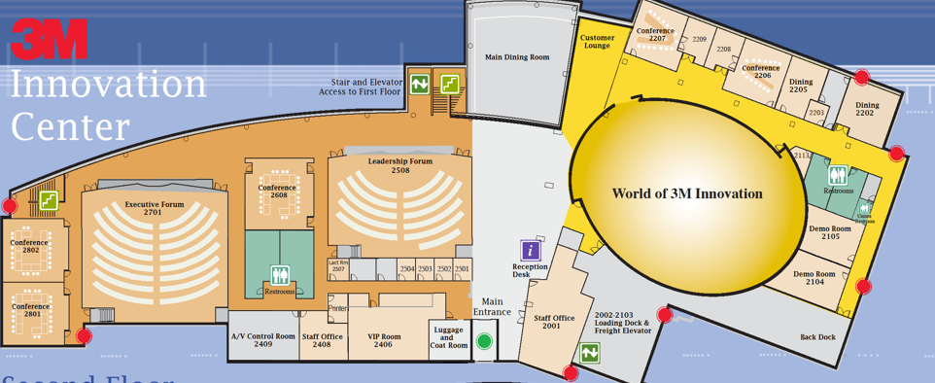


Slide 15

Thank you
3M.com/Sustainability
#LifeWith3M

