Slide 1
Accelerate Energy Productivity 2030

Slide 2



Accelerate Energy Productivity 2030 www.energy2030.org
Accelerate Energy Productivity 2030 is an initiative to double U.S. energy productivity from 2010 levels by 2030. Partners will:
raise awareness of the goal and its benefits,
co-create a roadmap to double energy productivity by 2030 and
catalyze concrete actions to be taken by private and public stakeholders.
Notes:
Amplify the national goal with private sector and subnational governments
Year of dialogues that generate interest and press mentions
New website highlighting productivity strategies (energy2030.org)
Develop a roadmap of pathways to achieve goal, including concrete actions
Analyze energy and GDP productivity pathways
Vet pathways at regional dialogues and update pathway content
Work with stakeholders to take action to meet the goal
Private sector and state and local leaders endorse goal
Leaders share productivity success stories

Slide 3
“[We] will take action aimed at doubling the economic output per unit of energy consumed in the United States by 2030, relative to 2010 levels.”
President Obama
2013 State of the Union
Notes:
Economic output defined in terms of $ real gross domestic product (GDP).
Energy use defined in terms of million British thermal units (MMBtu) of total primary energy.
Points to make: this is about both levers.
Manufacturing is a good example of something that moves both.
Net addition of 1.3 M jobs.
Each 1% increase in 2030 GDP over EIA Reference Case is equivalent to a 0.8 quad reduction in required energy savings, holding all else equal
Net addition of 1.3 million jobs from doubling energy productivity by 2030 (Rhodium Group)

Slide 4

Defining Energy Productivity
Energy Productivity = $\frac{GDP}{ Energy Use}$
Energy productivity is defined as: economic output (measured in gross domestic product USD) divided by the amount of energy used (measured in millions of primary British thermal units: MMBTU)
Most simply, increasing energy productivity means getting more out of every unit of energy we use
4

Slide 5
More Action Needed to Meet Productivity Goal
Goal: $271/MMBtu
21 quads additional savings required
Baseline: $136/MMBtu
Notes:
“I’m issuing a new goal for America: let’s cut in half the energy wasted by our homes and businesses over the next twenty years.”
- President Obama, State of the Union, Feb. 13, 2013
This effort supports the President’s goal to double U.S. energy productivity over 2010 levels by 2030. Doubling U.S. energy productivity – or getting twice as much economic output from each unit of energy – is an ambitious, yet attainable, goal that will greatly increase the competitiveness of our economy.
Goal: $271/MMBtu
Baseline: $136/MMBtu
While increasing energy productivity will require investments in all sectors of the economy, the investments will stimulate innovation, optimize domestic industry practices, support domestic energy production and bolster job creation.[1] Doubling energy productivity means powering more homes, going more places, and running more manufacturing plants using less energy. Simply put, it means making more money and improving well-being.
[1] Rhodium Group, February 2013.

Slide 6
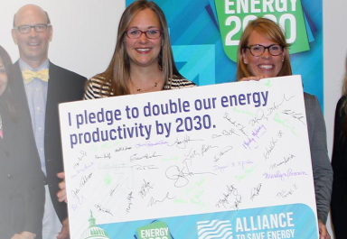
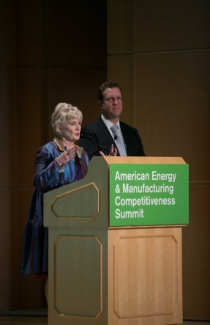
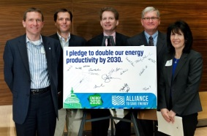
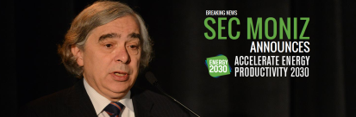
Accelerate Energy Productivity 2030 Events
Nov 2014 Washington, D.C.
Roundtable Launch Event
Feb. 4, 2015 Raleigh, NC
Buildings and Transportation
April 14, 2015 Seattle, WA
Smart Power
July 15, 2015 St. Paul, MN
Manufacturing
Sept. 2015 Washington, D.C.
Productivity Summit
Roadmap Release
Sept. 2014 Announcement
Notes:
Announced at American Energy & Manufacturing Competitiveness summit in Sept 2014
2-Day Regional Stakeholder Meetings Format:
Day 1 – Executive Roundtables
Day 2 – State and Local Dialogue - Open to Public
Post Summit – Follow-on work from Roadmap Release
Two key components of the roadmap
Identification and discussion of strategies/actions/pathways by actor (public sector, private sector, citizen)
Analytical framework to estimate GDP and energy impacts of aggregate strategies/actions/pathways

Slide 7


Things YOU Can Do
Provide Roadmap Strategies,
Endorse the Goal, and
Submit a Success Story.
Join us September 16th in Washington, DC for the Energy 2030 Summit!
www.energy2030.org
Notes:
Received over 100 endorsements across the nation
Some of the endorsers: 3M, 5 Lakes Energy, LLC, Ingersoll Rand, Opower, Seattle City Light, City of Ann Arbor, City of Grand Rapids, Copper Development Association, Danfoss, Whirpool, National grid, Dow, Cree, Schneider Electric, Johnson Controls, UTC, COC, ASE, Exelon Corporation , Legrand, Lockheed Martin
See website to become an endorser, and to see the full list of endorsers: http://www.energy2030.org/endorsers

