Slide 1
The Water Energy Nexus & Geothermal
Accelerate Energy Productivity 2030
July 16, 2015
St. Paul, MN
Presented by Aldie Warnock, SVP External Affairs, Communications, & Public Policy

Slide 2
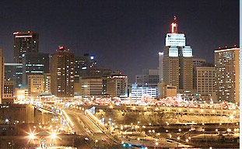
Water- Energy Nexus & Water Utility Efficiency
2-4% of U.S. energy consumption is for moving & treating water and wastewater
.
Energy extraction & generation require 4x more water than used by all U.S. residences
.
If every U.S. water utility improved their water pump / motor efficiency from the existing average of 55 % to the optimal efficiency of 80%, it would save enough electricity to light up St. Paul for 24 years.

Slide 3
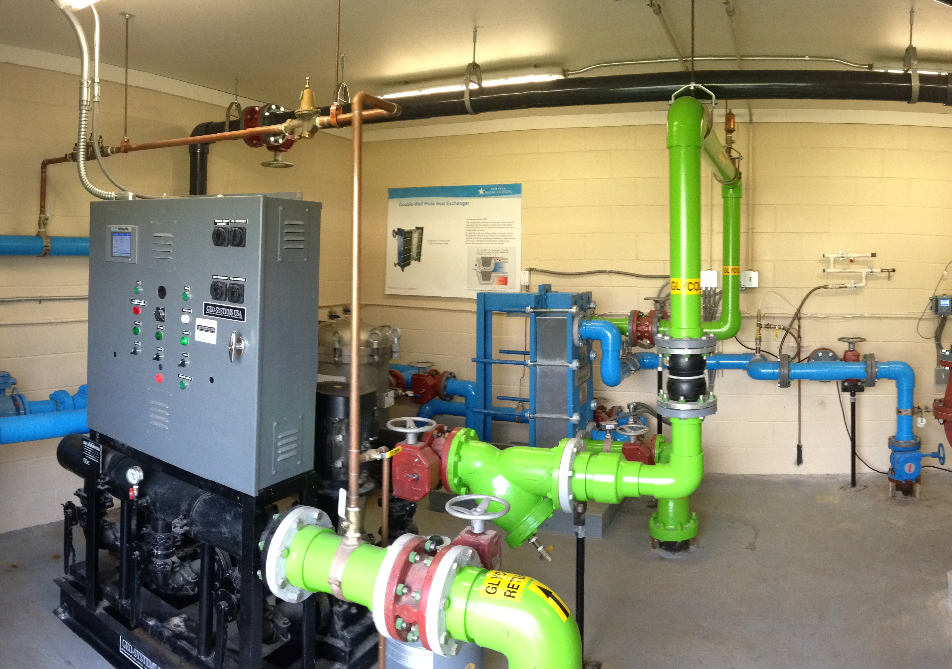
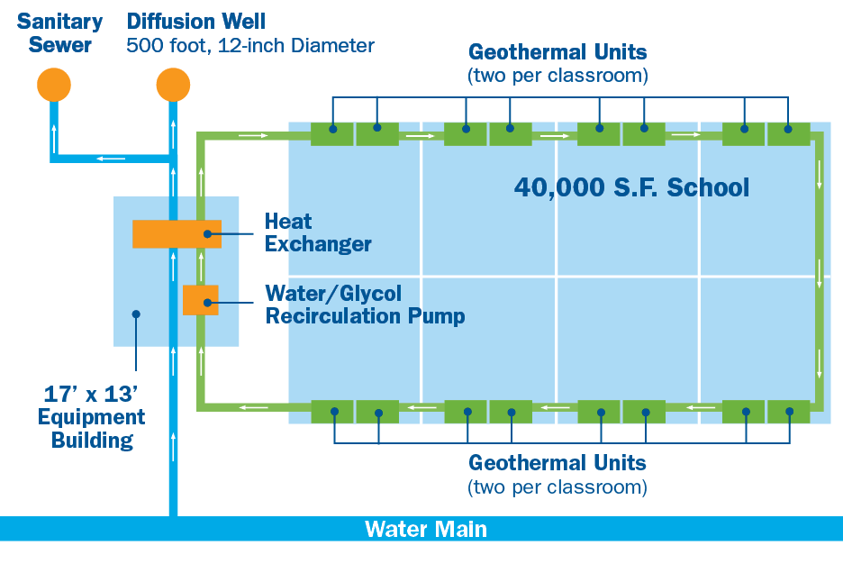
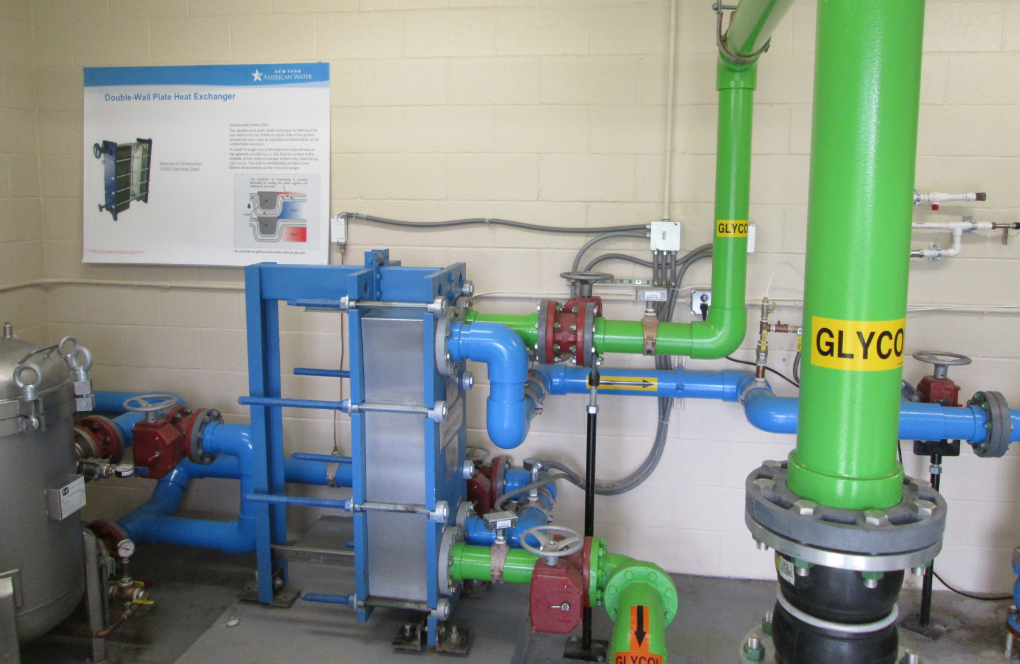
Geothermal Pilot System

Slide 4
Geothermal System: Final Configuration

